Slide 1
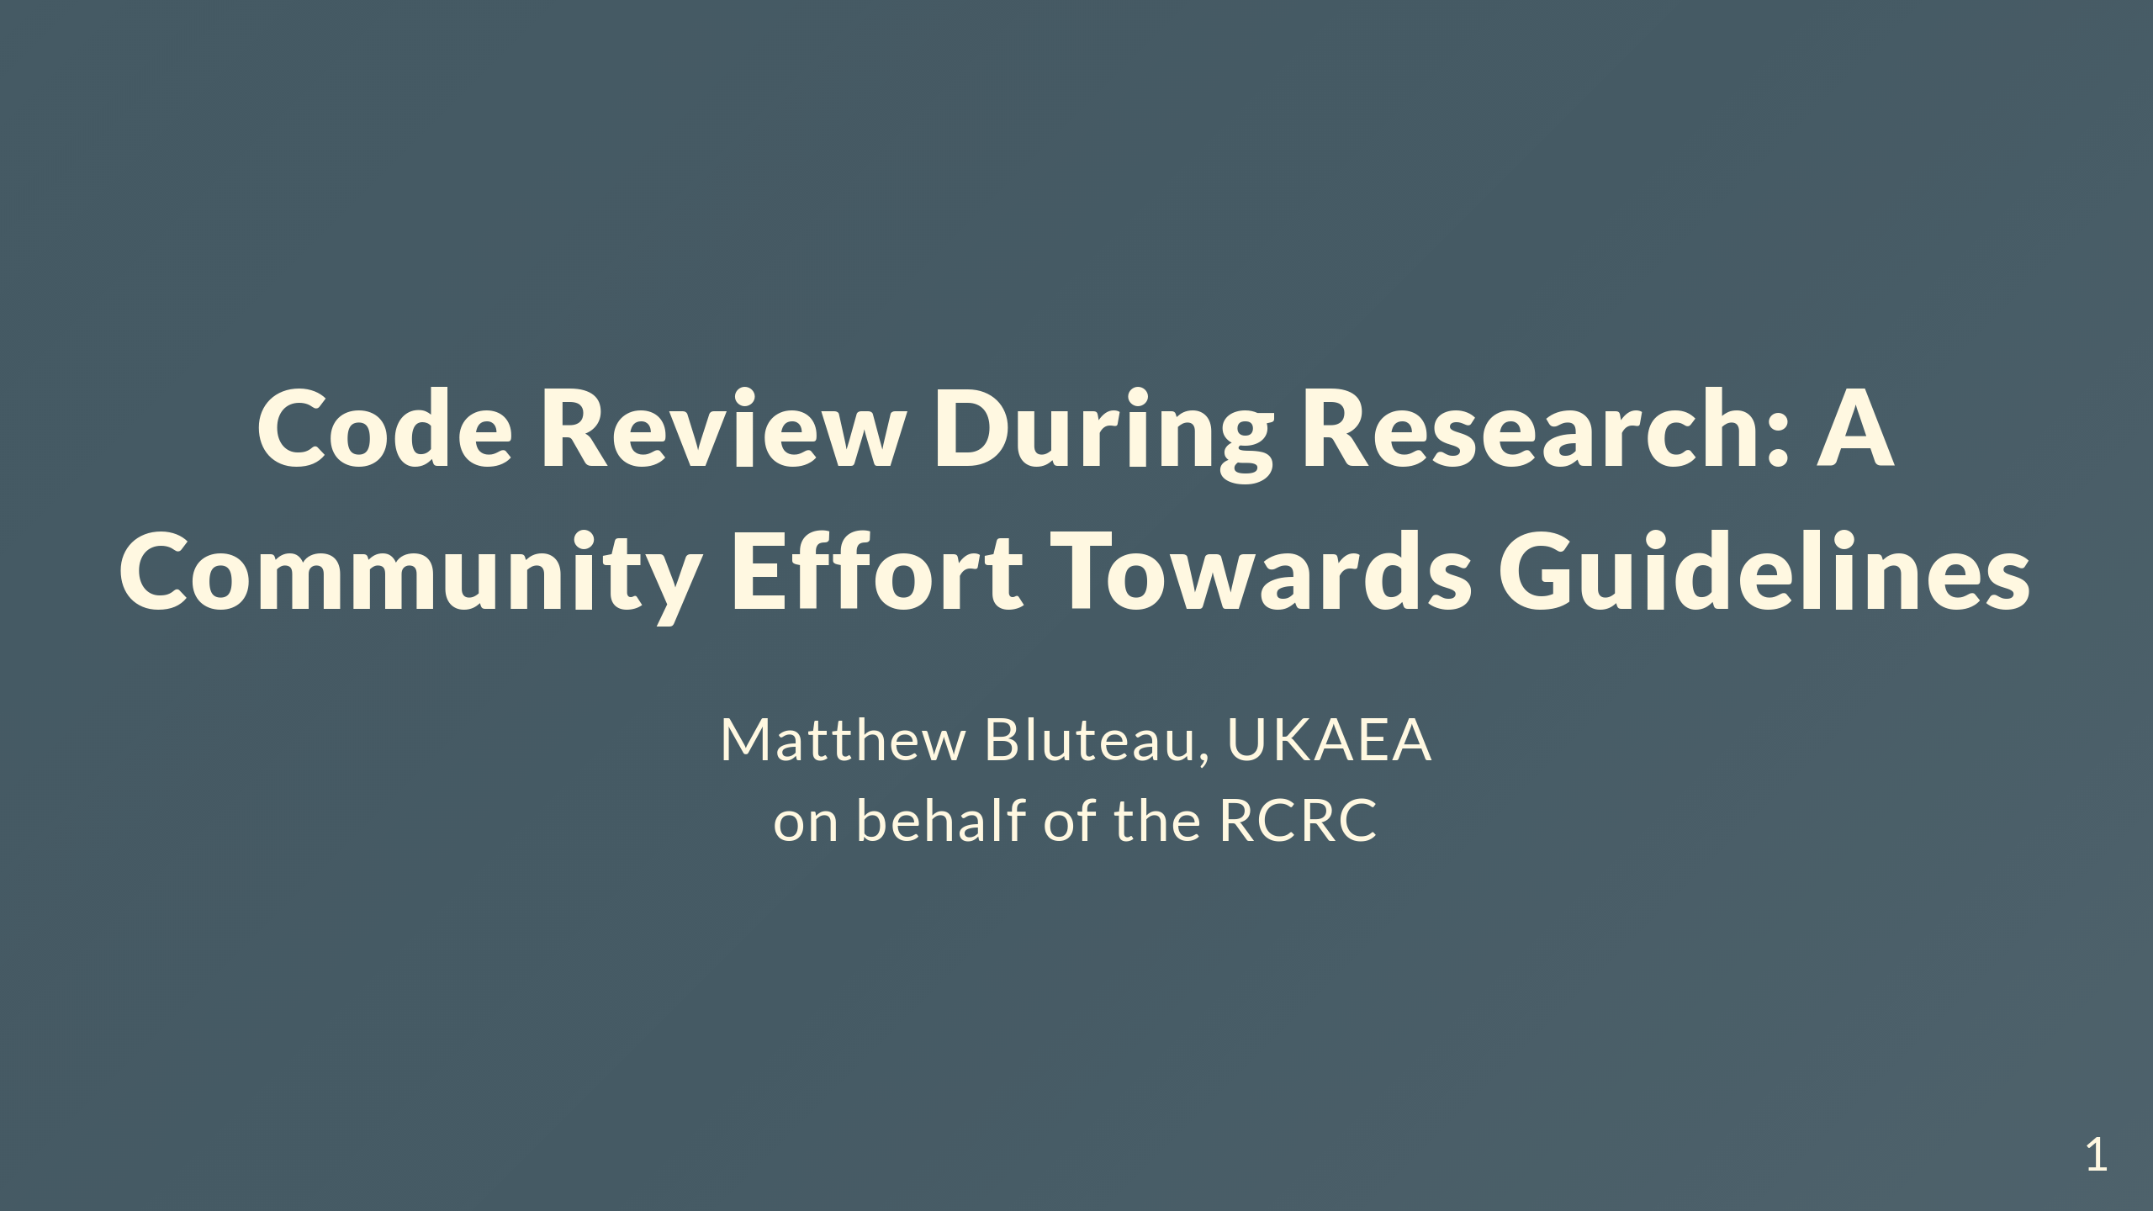

Slide 2
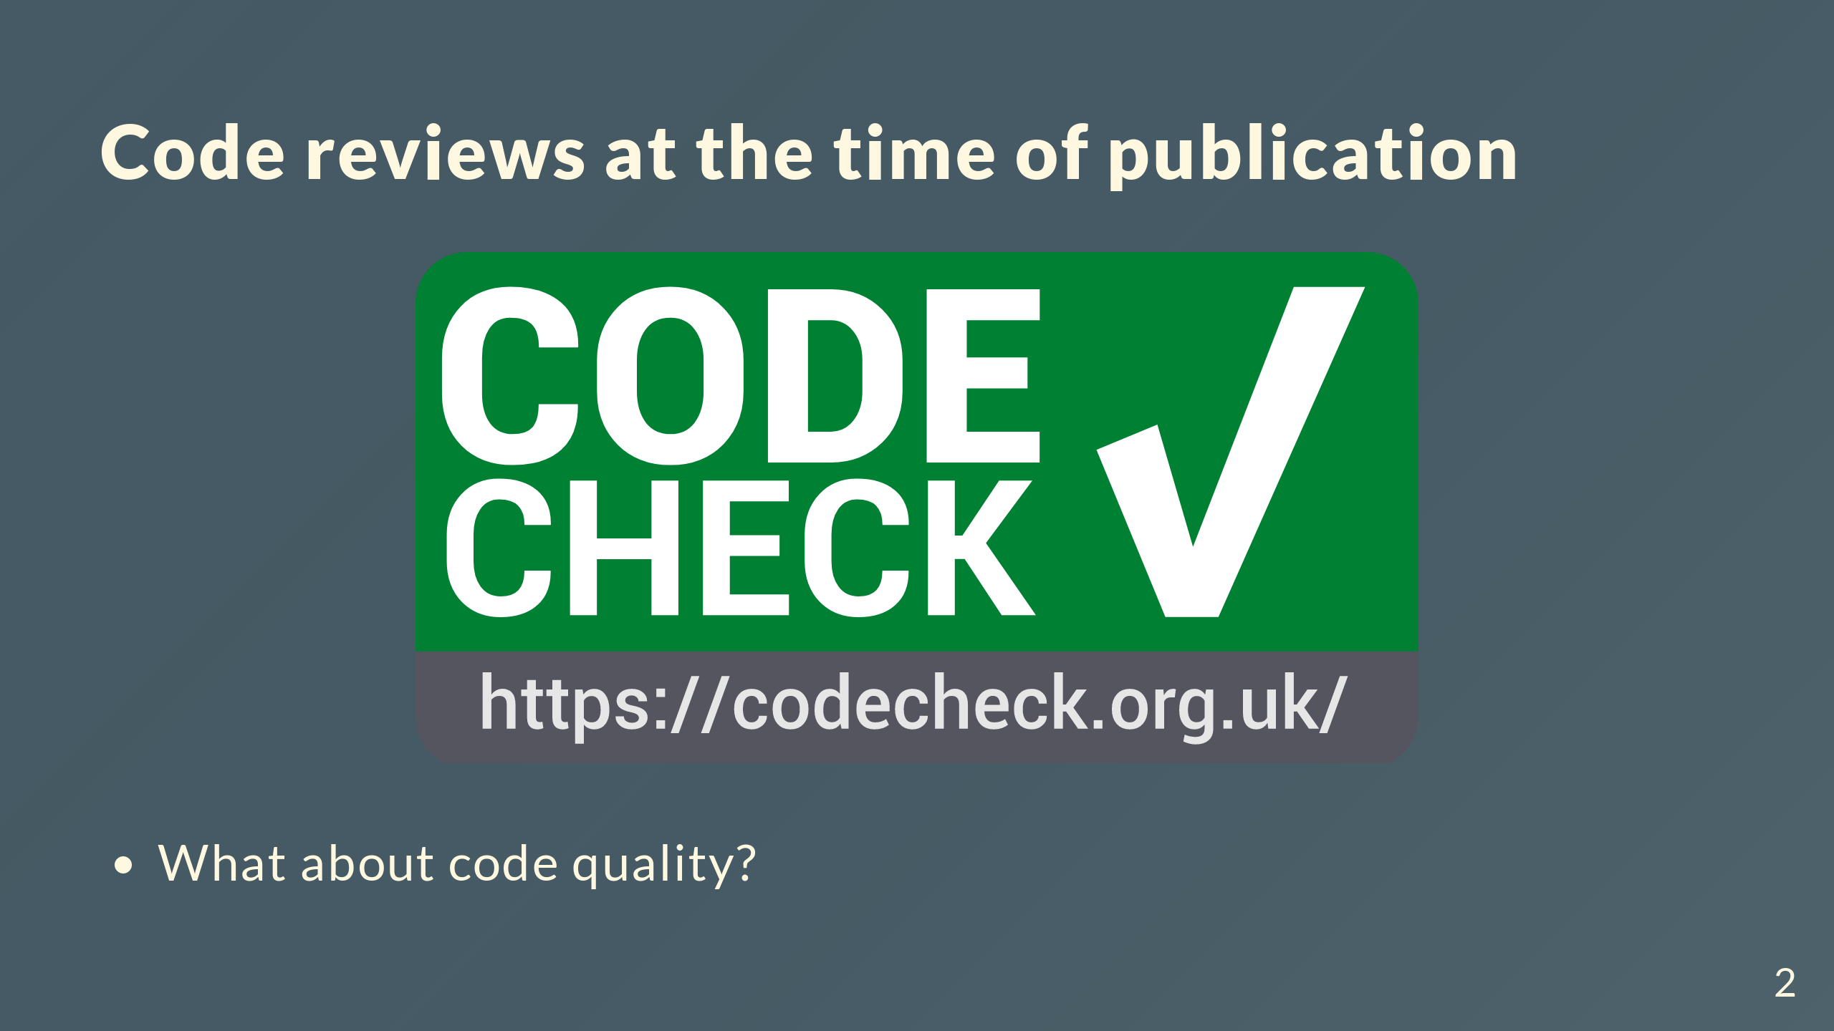
Notes:
- CODECHECK does code review at the time of publication. It's relevant for reproducibility and checking state of a codebase. - But what if the code is unreadable/unmaintanable? It's too late for a rewrite.

Slide 3

Notes:
- There is a need for code review /during research/. - A different kind of code review: informal, low-stakes and frequent. Something you would with colleagues once a week. - Focus on code quality. Does not replace publication-time review - but is complementary.

Slide 4
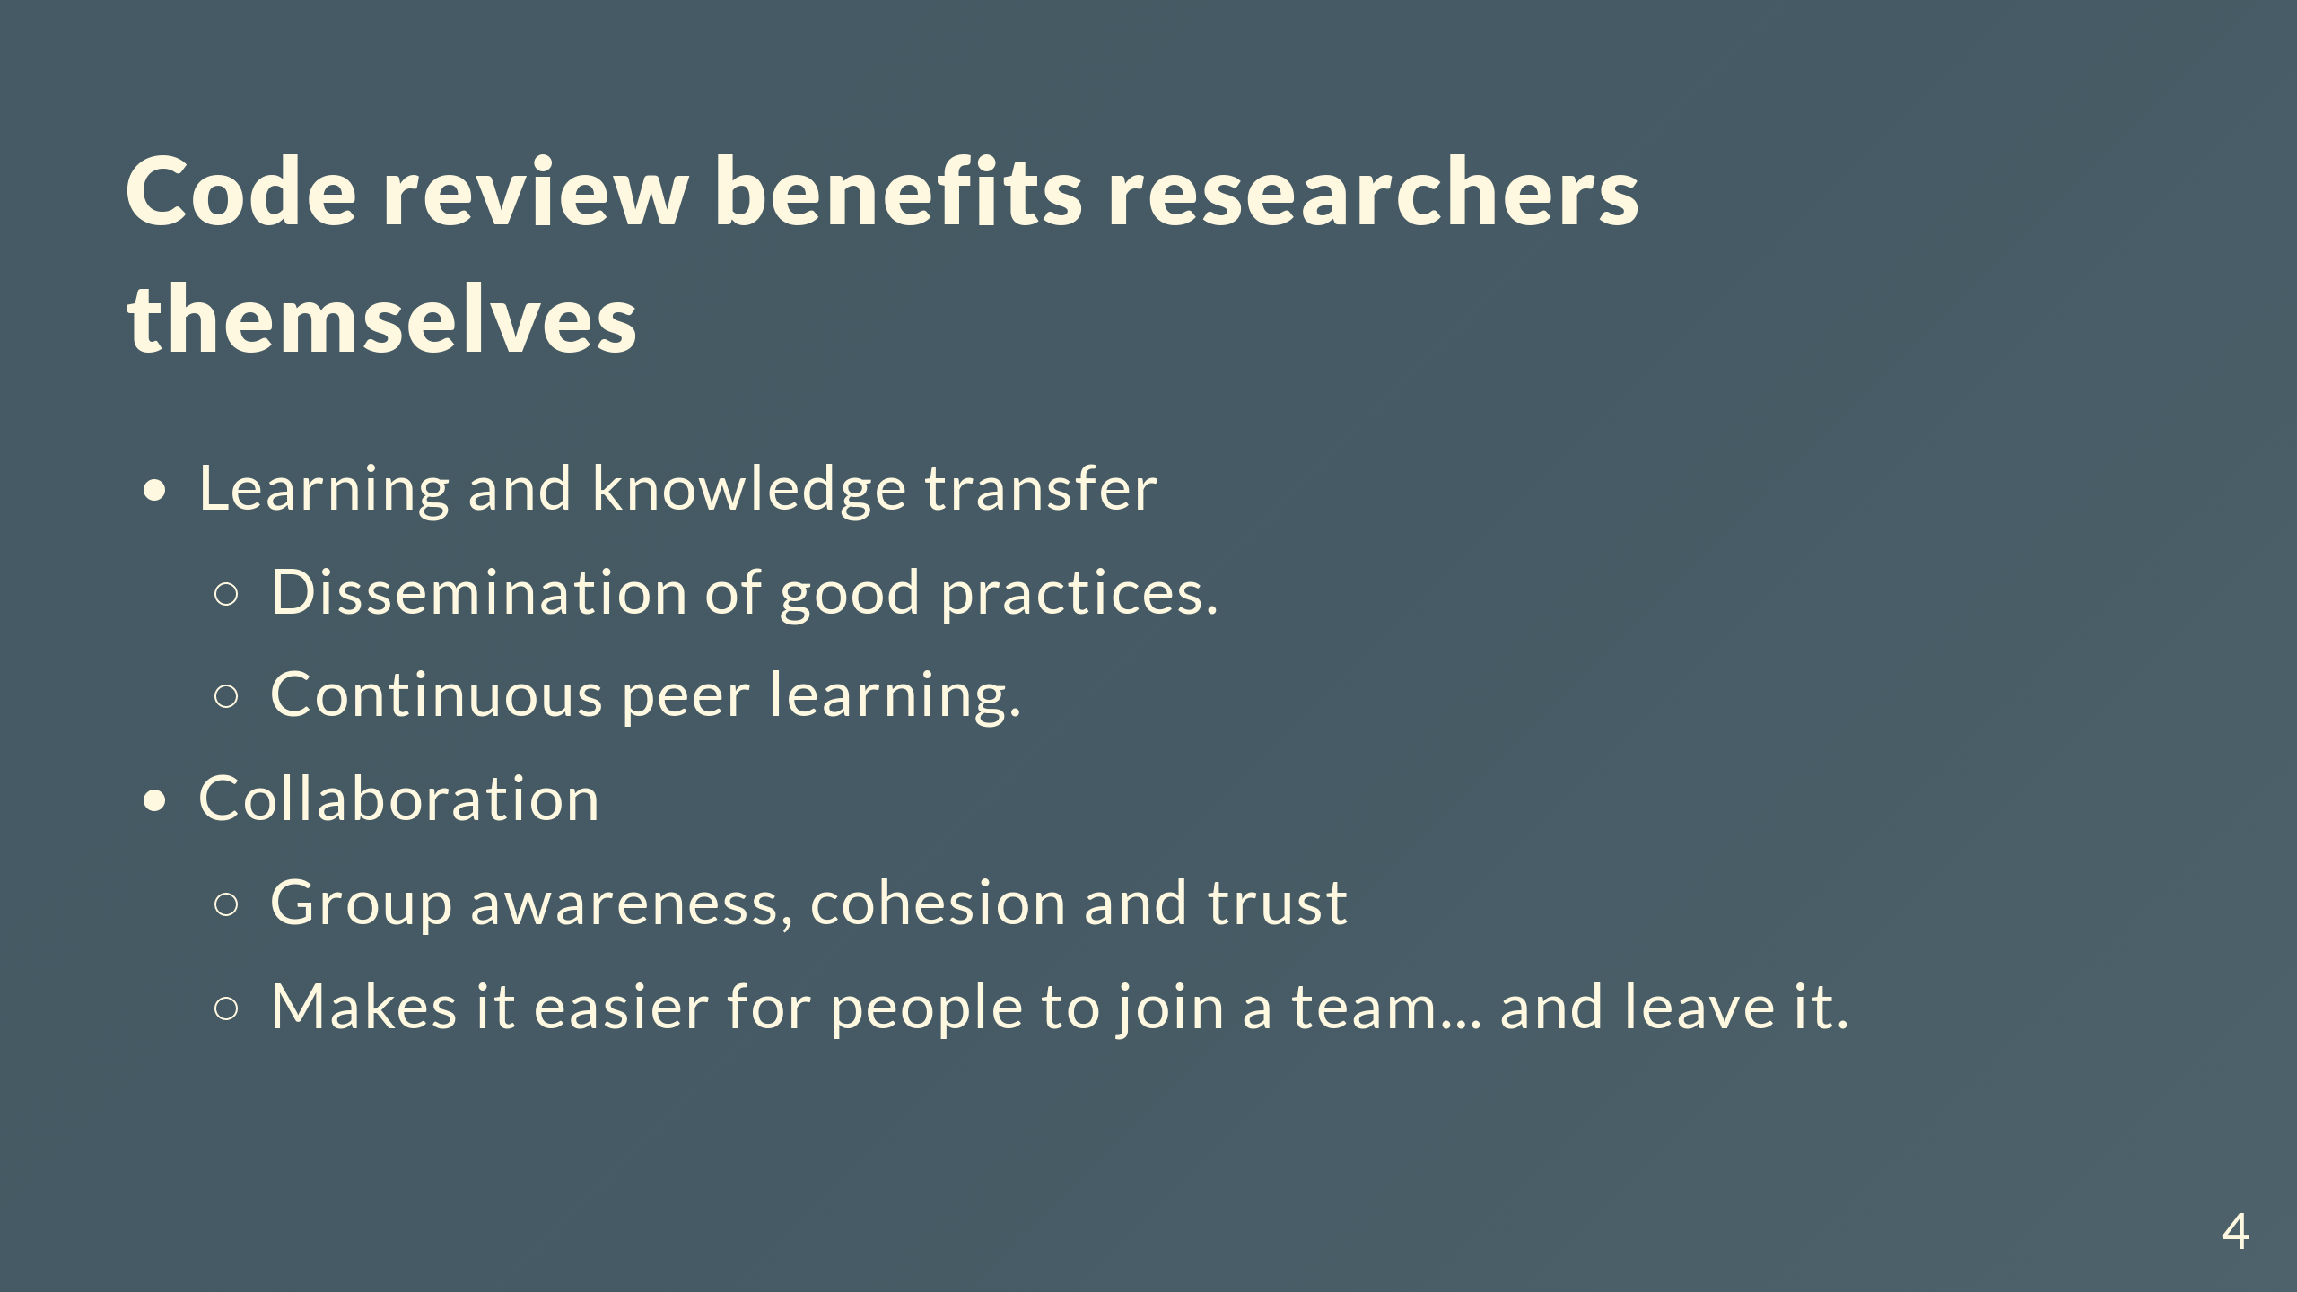
Notes:
- Code review during research has benefits beyond better code quality. - Learning and knowledge transfer + Mentoring and dissemination of experience and good practices. + More experienced programmers are exposed to new patterns and approaches. + Good example: group of students at Imperial College London who started doing code review sessions with Thibault and as a result set up a framework for handling inputs to their codes - Collaboration + Regular meetings and discussions increases group awareness, trust and cohesion. + Specific technical knowledge is spread. Easier for newcomers, reduce impact of leavers.

Slide 5
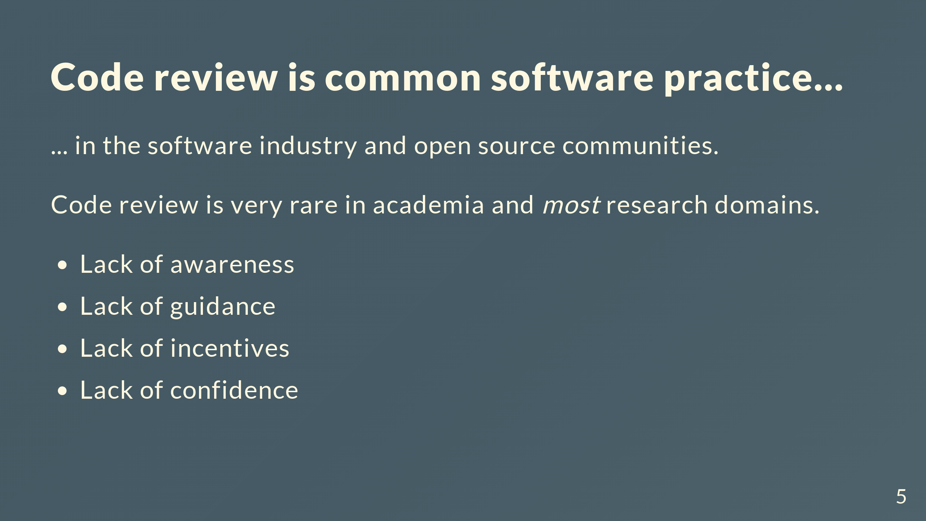
Notes:
- Code review is common in the software industry and open source communities, but very rare in research. - Lack of awareness and guidance on how to do code review in a research context. Most material out there is targeted at the software industry and open source projects. - Establishment of code review culture will probably struggle with lack of incentives for code quality and lack of confidence. - Target the first two points for the most immediate impact

Slide 6
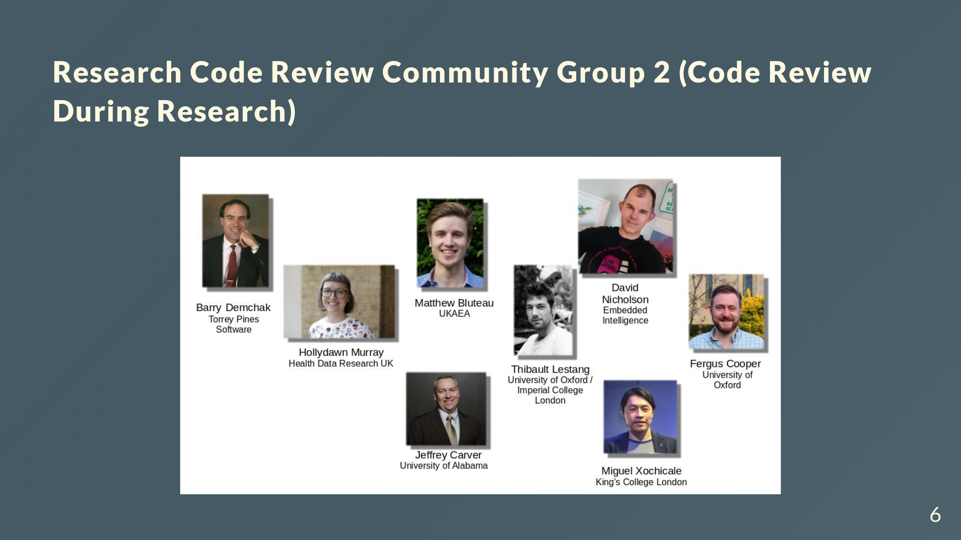
Notes:
- UK/US based group of researchers and RSEs. - Started as one of the working groups of the Code Review Community. - There were other groups in the community, e.g. code review at publication, EDI considerations for code review, stakeholders and policy, etc - Unfortunately, these lost momentum and never produced anything concrete - In practice, guidelines as website. Living document that is open to contributions.

Slide 7
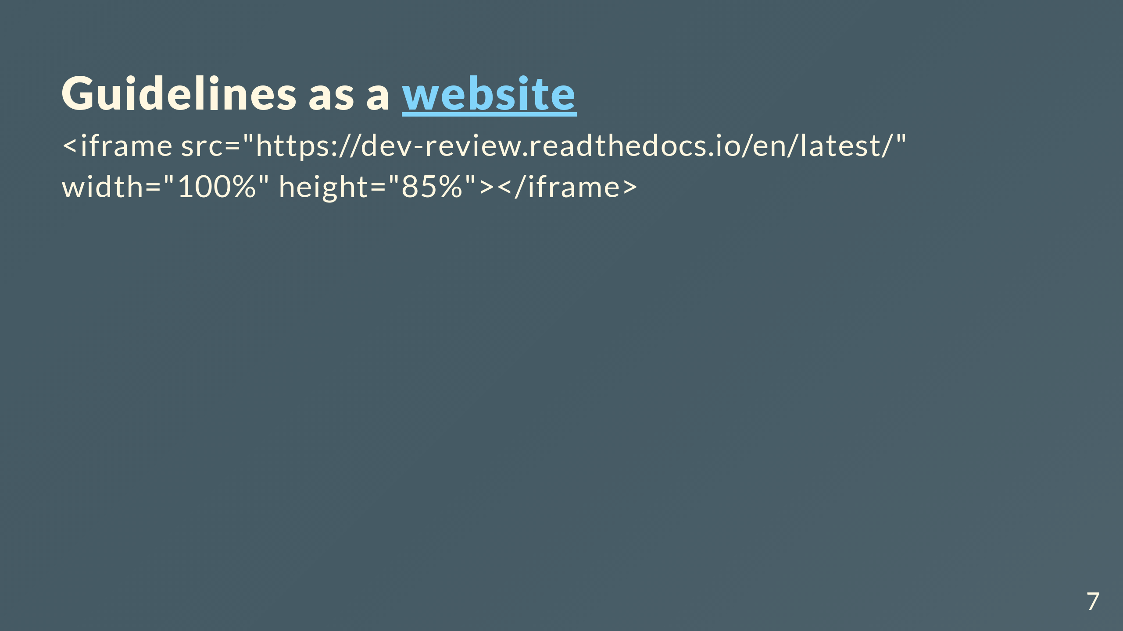

Slide 8
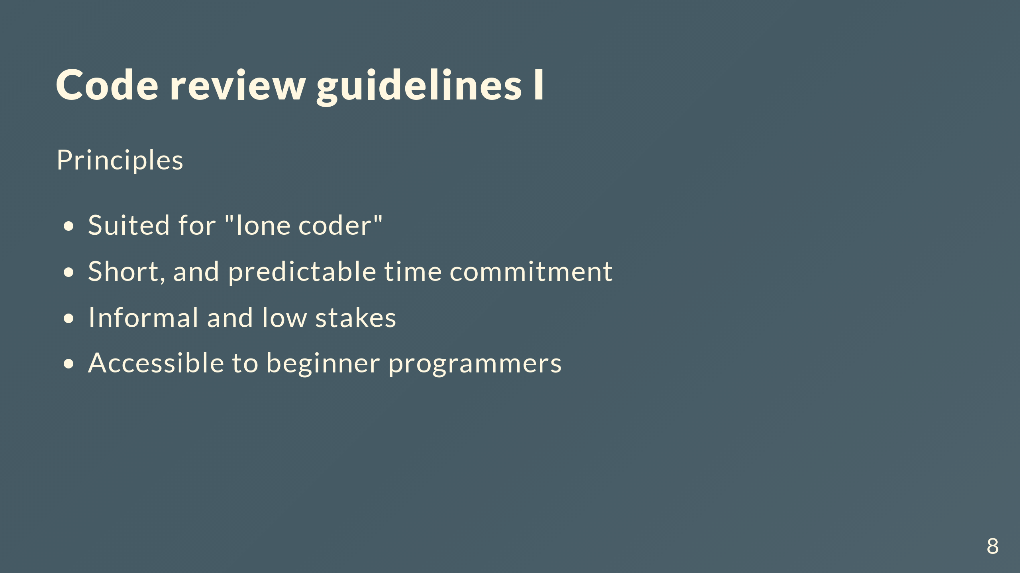
Notes:
- Suited for lone, perhaps isolated, research developpers. - Short, fixed duration. Can fit into a busy schedule with possibility of iteration. - Informal and low stakes. - Accessible to less experienced programmers (e.g. resaercher how would not think of themselves as programmers).

Slide 9
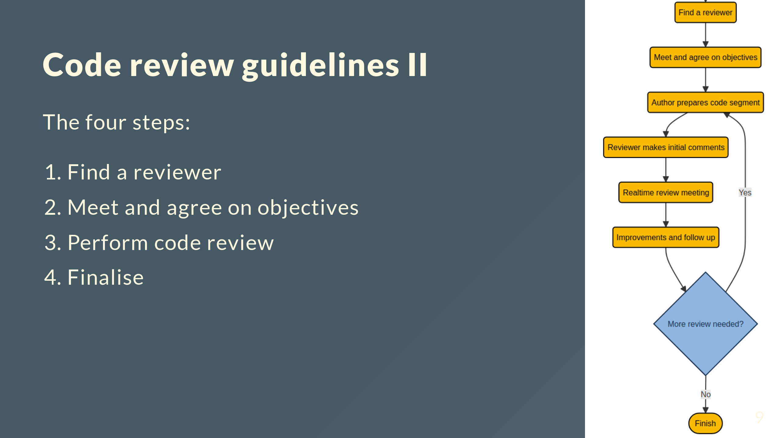

Slide 10
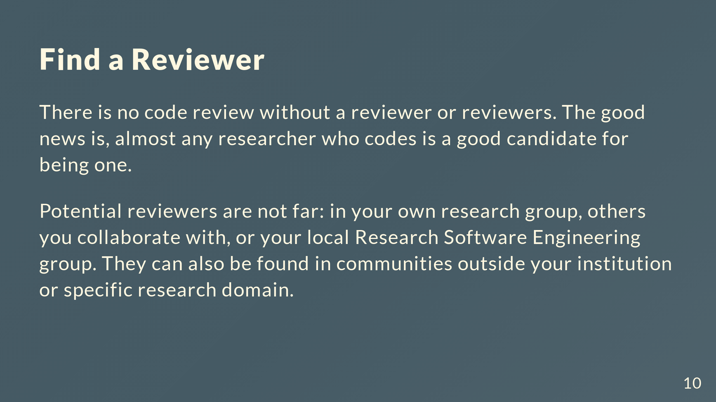

Slide 11
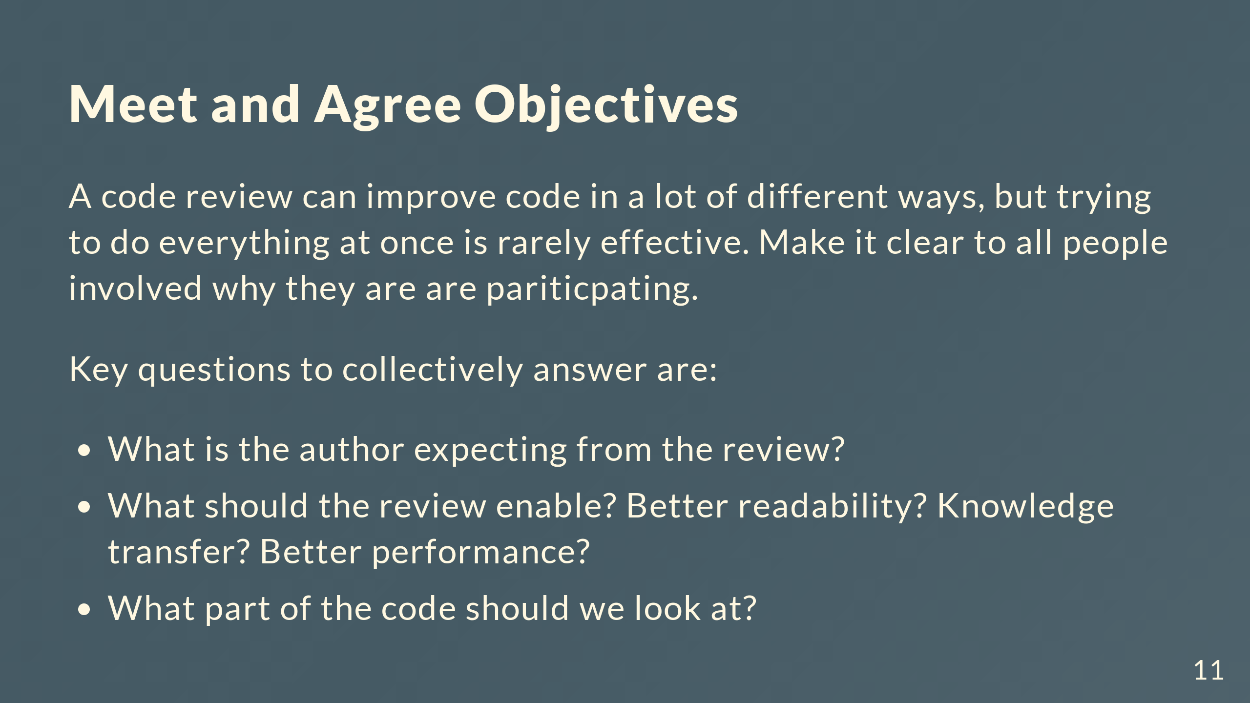

Slide 12
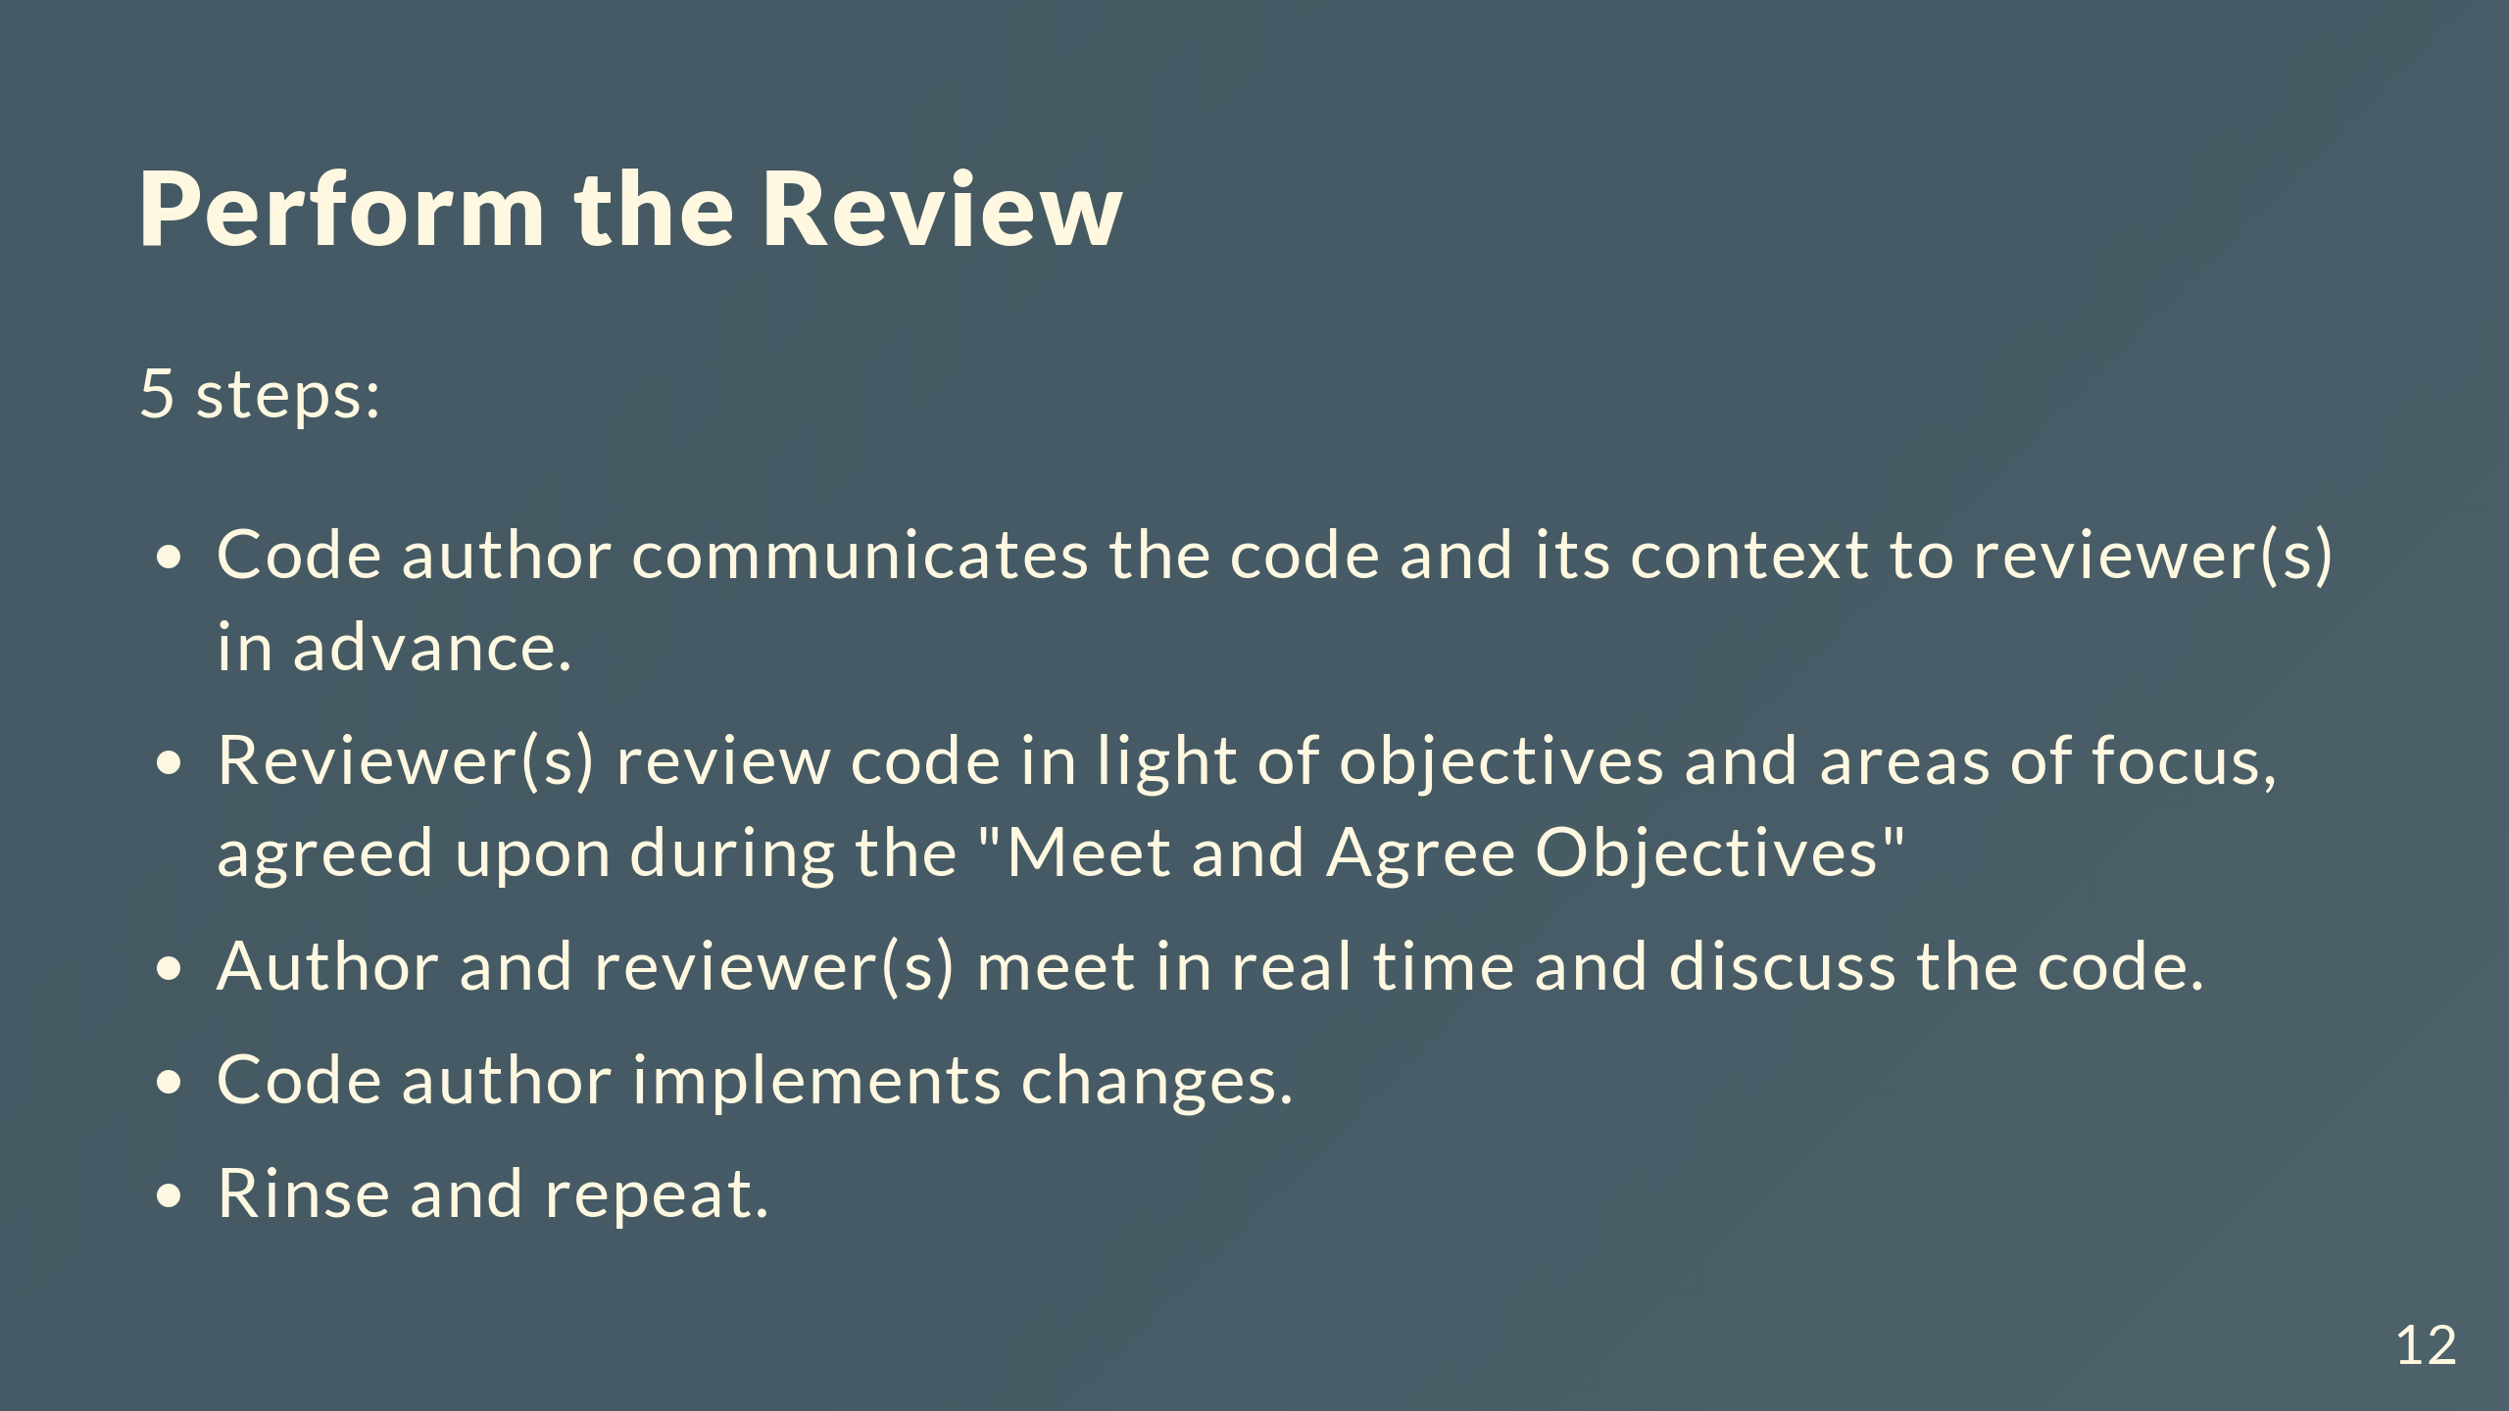

Slide 13
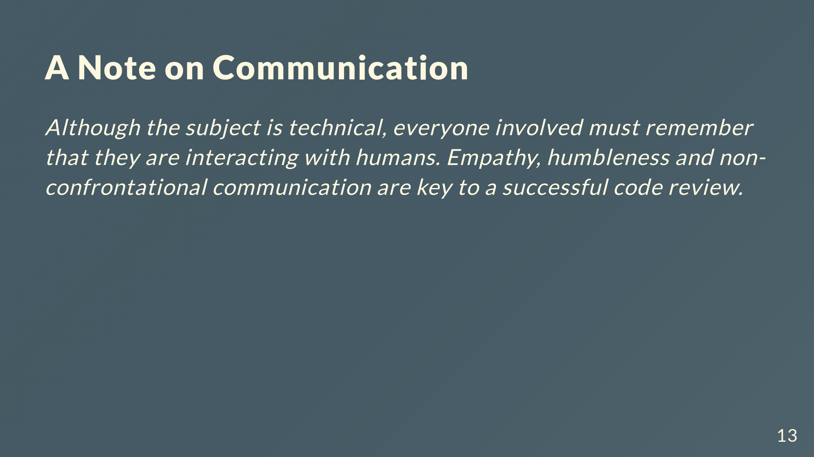
Notes:
- This applies to all stages, but particularly when meeting to discuss the code in person (or leaving an asynchronous comment)

Slide 14
